Slide 1


Introduction to UIL
A+ Academics
Sulphur Springs Middle School
2021-2022

Slide 2
UIL A+ Academics Overview
A brief description of each event is included in this presentation. You will be emailed a link to a Microsoft Form. If you are interested in any event(s), please fill out the form so we can get you matched up to the coach of your event choice. Please fill out forms no later than Monday, September 9th.
Students may choose one or two events. Some events conflict with each other, so we will contact you with options if you pick two events that this happens with.
Practices will be held during CAT time which is also when select choir, band and strings occasionally meet so you will have to divide your time wisely if you are involved in more than one activity. Some before or after school practices may be required.
The location of our UIL A+ Academic district meet will be decided soon. I will send a note home with students practicing in UIL events as soon as the location is decided and the date is determined. If you are on a UIL team, you must attend this contest.
Medals are awarded to individuals who earn any of the 1st – 6th place spots at the district meet. Team members of teams who earn 1st, 2nd or 3rd place will receive ribbons. Schools with the most finalists earn points toward grade-level trophies and the sweepstakes award.

Slide 3
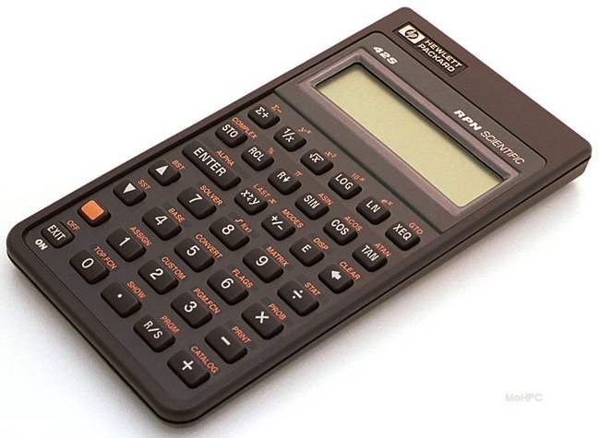
Calculator Applications
The Calculator Applications event is designed to stimulate the development of mathematical and calculator skills. The contest consists of working out problems which may include addition, subtraction, multiplication, division, roots, and powers. If you’re a quick thinker and quick at using a calculator, then this is the event for you.
Coach – Ms. Denton
mdenton@ssisd.net

Slide 4

Dictionary Skills
Students will be tested on their abilities to find information in a dictionary effectively and efficiently. The quicker you are in finding information, the more successful you’ll be.
Coach – Mrs. McClure
cmcclure@ssisd.net

Slide 5

Editorial Writing
The editorial writing contest is designed to develop the persuasive writing skills of the participants. Students must advocate a specific point-of-view in response to a prompt. Students have 45 minutes in which to complete their editorials.
Coach – Ms. Thomas
chthomas@ssisd.net

Slide 6

Maps, Graphs, and Charts
This contest will measure skills such as using an atlas as a reference book to locate information, make comparisons, estimate and approximate. This is done by using scales, interpreting grid systems, legends, and keys.
Coach – Mrs. K. Isonhood
kimberly.isonhood@ssisd.net

Slide 7

Mathematics
This event is for students who are able to complete mathematical problems quickly. It includes working with problems covering numeration systems, such as operations involving whole numbers, integers, fractions, decimals, exponents. It also includes order of operations, probability, statistics, and a whole lot more.
Coach – Mrs. Gentry
kgentry@ssisd.net

Slide 8

Oral Reading - Poetry
Love Poetry? In this contest, a published poem will be performed by the contestant. The student will learn to recite a poem using different tones of voice. They will build their vocabulary of feeling, train their emotional intelligence, and prepare themselves to speak more accurately and confidently about any piece of writing.
Coach – Ms. Perez
awells@ssisd.net

Slide 9

Oral Reading - Prose
Express yourself! In this contest, contestants will read one or more selections for a maximum of six minutes. They should be able to use their voice and body movement to clearly portray the mood and characters in the selection.
Coach – Mrs. Glenn
hglenn@ssisd.net

Slide 10

Science
The emphasis for the science contests will be placed on knowledge of scientific fact, understanding of scientific principles, and the ability to think through scientific problems. The contests are designed to test not only memory, but also the ability to think critically about science and scientific processes and concepts.
Coach – Mrs. Holloman
kholloman@ssisd.net

Slide 11

Spelling
Contestants in this event will be tested on the ability to spell proficiently, write clearly, and capitalize properly. Students will write down words given by the pronouncer at a rate of approximately five words per minute.
Coach – Miss Thorsen
tthorsen@ssisd.net

Slide 12

Art
This contest involves the study of a select group of paintings and pictures. Part of the contest requires the contestant to identify the names of 15 selected artists and titles of pictures selected randomly by the director from the official list of 40 pictures. Part B consists of 30 questions about art history and art elements characteristic of the 40 art selections.
Coach – Ms. Ortloff
jortloff@ssisd.net

Slide 13

Chess Puzzle
Contestants in a Chess Puzzle-Solving contest receive a paper-and-pencil test that includes a series of chess boards with pieces in particular positions. The contestant must then determine the fewest moves to checkmate given that particular board layout. Time is also a factor - contestants are scored based on the most puzzles solved in the least amount of time.
Coach – Miss White
awhite@ssisd.net

Slide 14

Impromptu Speaking
In Impromptu Speaking, students are given a prompt and prepare a speech on it. No notes are allowed. This event involves quick thinking, organizing ideas, and delivering those thoughts to a small audience effectively. If you’re capable of choosing any topic and preparing a short speech without any notes, then this is for you!
Coach – Mr. McClure
tmcclure@ssisd.net

Slide 15

Listening Skills
How good are your listening skills? In this event, you can put your skills to the test by listening to a short 7 – 10 minute script, taking notes as needed, and using your notes to answer 25 multiple choice, fill-in-the-blank, and true/false questions.
Coach – Mrs. McCain
bmccain@ssisd.net

Slide 16

Modern Oratory
Do you like to convince people to take your side on an issue? The contestant will write in advance a persuasive speech (3-6 minutes long) about one of five set topics, and then deliver the speech entirely from memory! The contestant must determine critical issues of the topic and explore both sides of the issue before choosing a position to defend. Picture a lawyer presenting his closing argument in front of a jury. Now, imagine that lawyer being you. If that grabbed your attention, then join the Modern Oratory team.
Coach – Mrs. Lilley
alilley@ssisd.net

Slide 17

Music Memory
Do you like music? Students will listen to approximately 20 seconds of up to 20 musical selections and identify the name of the major work, selection and the name of the composer. Spelling and punctuation are graded as well.
Coach – Mr. Lovelady
alovelady@ssisd.net

Slide 18

Number Sense
Are you good with numbers? Are you the type of person that is able to solve math problems without using a pencil or calculator? Then join the number sense team where you’ll learn to develop and practice shortcuts to solve mental math problems. Tests are taken using a blue pen so the answer you first write down is the answer you will keep – no erasures or mark outs allowed.
Coach – Mrs. Giles
sgiles@ssisd.net

Slide 19

Ready Writing
Ready, set, write! This event helps students build and refine their writing skills. Contestants will choose between two prompts and use their creative ideas to explore a topic or prove a point. If you love to write, then you’ll love this event.
Coach – Mrs. P. Isonhood
pisonhood@ssisd.net

Slide 20

Social Studies
This contest is designed to encourage students to expand their knowledge of social studies, particularly in the areas of history, government systems, economics, citizenship, & culture. If your interest lies in wars, history, and politics, this contest will give you more than enough material to explore.
Coach – Mrs. Crump
jcrump@ssisd.net

Slide 21
Coaches for UIL Events
Art – Ms. Ortloff – jortloff@ssisd.net Calculator – Ms. Denton – mdenton@ssisd.net Chess – Miss White – awhite@ssisd.net Dictionary Skills - Mrs. McClure – cmcclure@ssisd.net Editorial Writing – Ms. Thomas – chthomas@ssisd.net Impromptu Speaking – Mr. McClure – tmcclure@ssisd.net Listening – Mrs. McCain – bmccain@ssisd.net Maps, Charts & Graphs – Mrs. K. Isonhood – kimberly.isonhood@ssisd.net Mathematics – Mrs. Gentry – kgentry@ssisd.net | Modern Oratory – Mrs. Lilley – alilley@ssisd.net Music Memory – Mr. Lovelady – alovelady@ssisd.net Number Sense – Mrs. Giles – sgiles@ssisd.net Oral Reading – Poetry – Ms. Perez – kperez@ssisd.net Oral Reading – Prose – Mrs. Glenn – hglenn@ssisd.net Ready Writing – Mrs. P. Isonhood – pisonhood@ssisd.net Science – Mrs. Holloman – kholloman@ssisd.net Social Studies – Mrs. Crump – jcrump@ssisd.net Spelling – Ms. Thorsen – tthorsen@ssisd.net

Slide 22

For more information:
Visit www.uiltexas.org and look under A+Academics for more information about the individual events.
Or Contact: Mr. Denton in Room 2313 email jdenton@ssisd.net

